Slide 1
Google studio report on chess statistics
AYMERIC DEMANGE

Slide 2
Summary
Project Overview
Quick resume of how chess works
How game opening influence a win
4 Months of data
Conclusion

Slide 3

Project Overview
How some opening, beginning and conditions can influence a win in a chess game ?
Notes:
Fusionné les applis de lecture de manga avec la possibilité de créer un manga

Slide 4
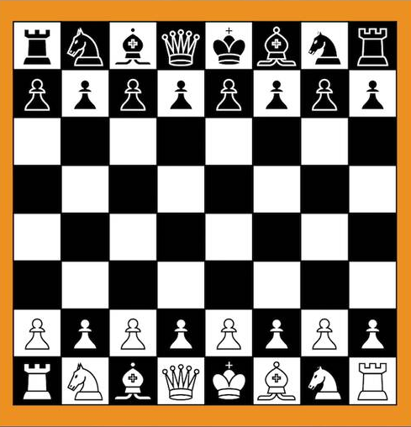
Quick resume of how chess works
The white move his pawn from d2 to d4
1 – Whites start first
2 – Each pawn move in a certain way
3 – To win, the king need to fall
Each move can be describe like a map (Example above d2 to d4)
Notes:
Partie pour créer ou lire un manga, existe déjà mais simplifier la chose

Slide 5
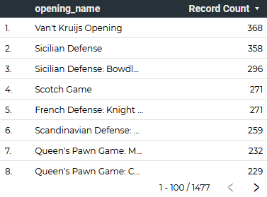
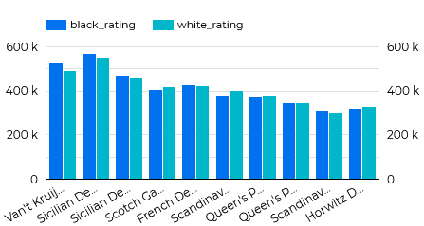
How game opening influence a win
There are 1327 differents openings in chess
KPI : Record Count
Number of tactics used in competition
Winrate depending on opening used
Openings are very important to decide the victory

Slide 6
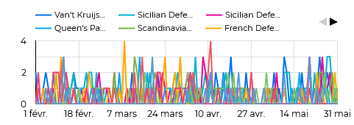
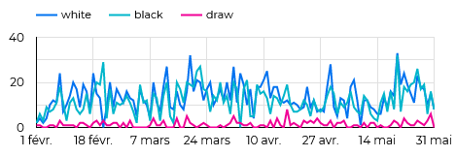
4 Months of data
From 1 February to 31 of May
KPI : Who’s side got the most chance of winning
How many times a tactics has been used
Which side won

Slide 7
Conclusion
Chess is a very complex game
Knowing the openings are essential
Having the white side is a winning key
Many games comes to an end due to the timer
Notes:
Indicateur de performance du profil du créateur de Manga. Permet de savoir les scores de visionnage.

